Slide 1
SQL
Creating PrestigeCars DB
Project 2.5
Muhammad Ali Sajjad, Jean Gomez,Chao Wang, Yevgeniy Sumaryev, Andy Qu
7:45 AM GROUP 2

Slide 2
Project Overview
Understand Project Overview
Our first goal was to ensure that we as a team had an understanding of the project at hand. Despite the coming holiday we had to get the ball rolling early in order to make headway
Mapping using Data Modeling
Utilizing a data modeling tool we mapped out the tables and their respective relationships. This enabled us to have a top down view of the PrestigeCars Database
Building Views and TVF
After the core data tables were constructed we aimed to improve the usability of our DB by creating data views and table valued functions that return data in a usable manner.
11/22
11/26
11/28
11/20
11/24
11/27
Table Relationships
We next aimed to figure out the relationships between tables and build the necessary dependencies using primary and foriegn keys.
Building Tables
We designated team members to construct the necessary tables regarding Data schema. Afterwards we had meetings to refactor our code to ensure accuracy and reliability
Normalization and Data Cleansing
In order to increase the cohesiveness of our DB. We aimed to normalize the data as much as possible in order to maximize the efficiency of our data and allowing for adequate data cleansing

Slide 3
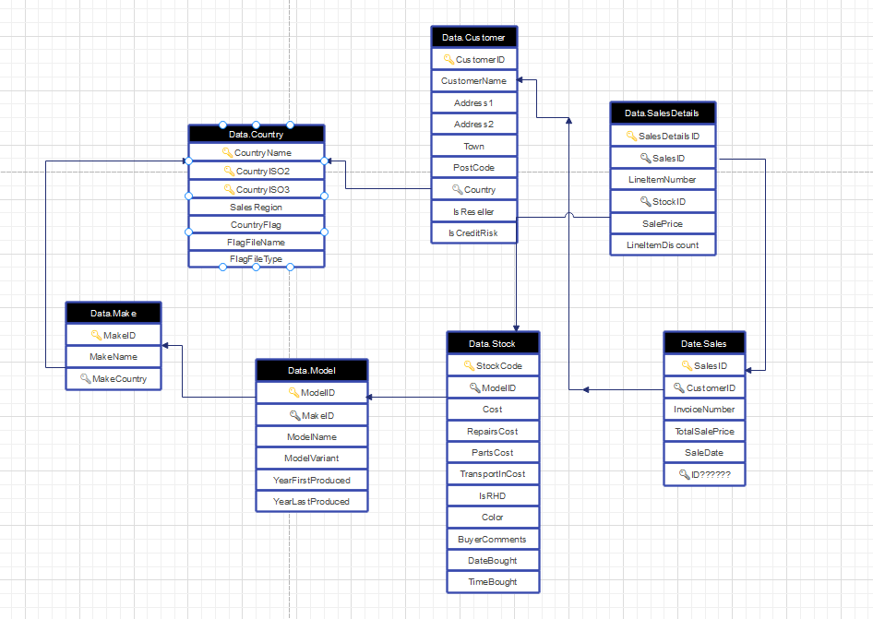
PrestigeCars Prototype
Pre-Production

Slide 4
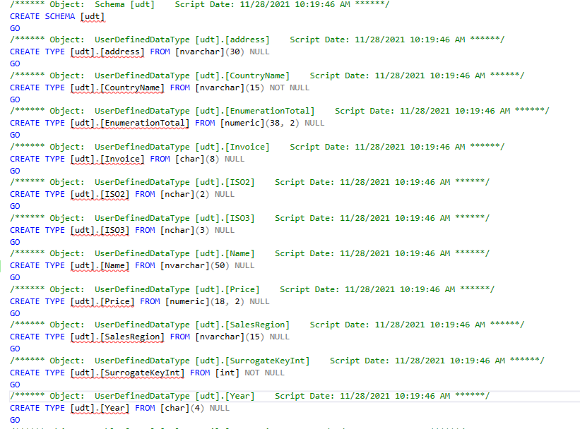
User Defined Types

Slide 5
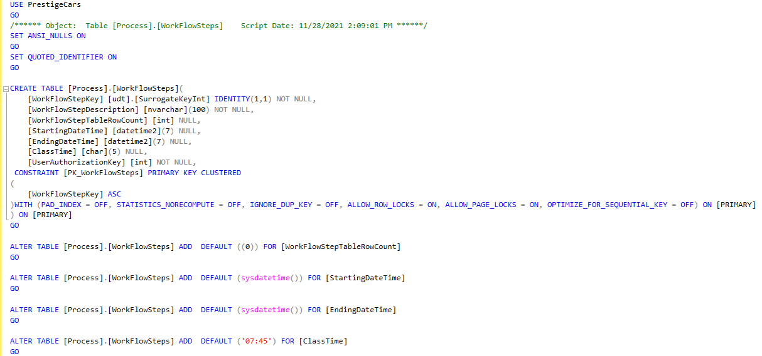
Process.WorkFlowSteps

Slide 6
Redgate SQL Prompt, SQL doc
Using Redgate SQL Prompt and SQL doc helped with our productivity by being able to see the connections between tables, see all the data connected to each specific table and also write SQL code faster and more efficient
Some of the tools used were SQL doc, DB connectivity diagram, tab history, autocompletion and data generation

Slide 7
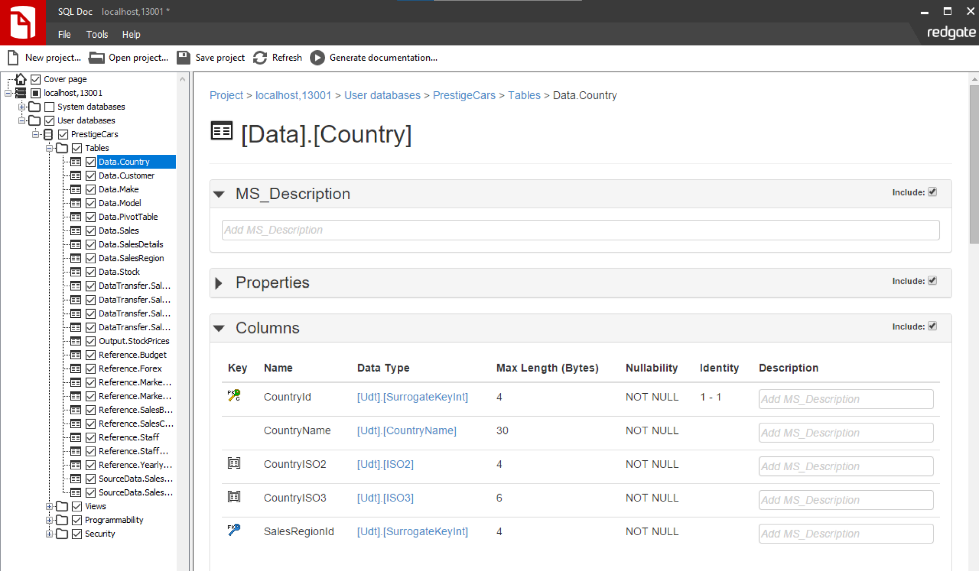
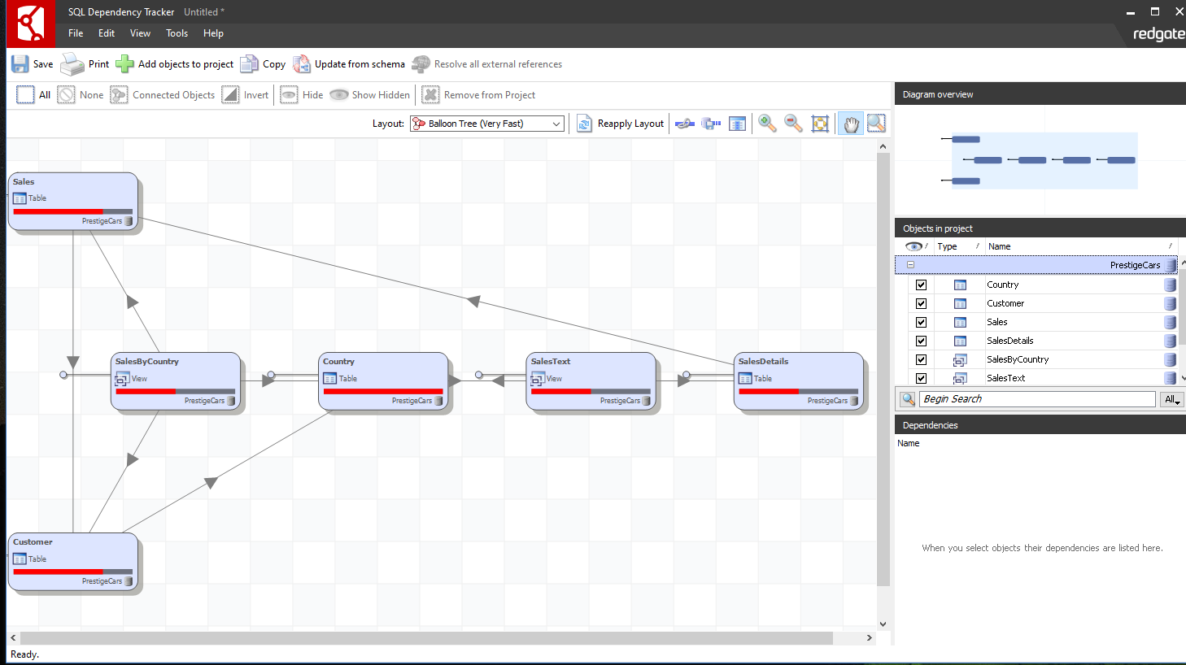

Slide 8
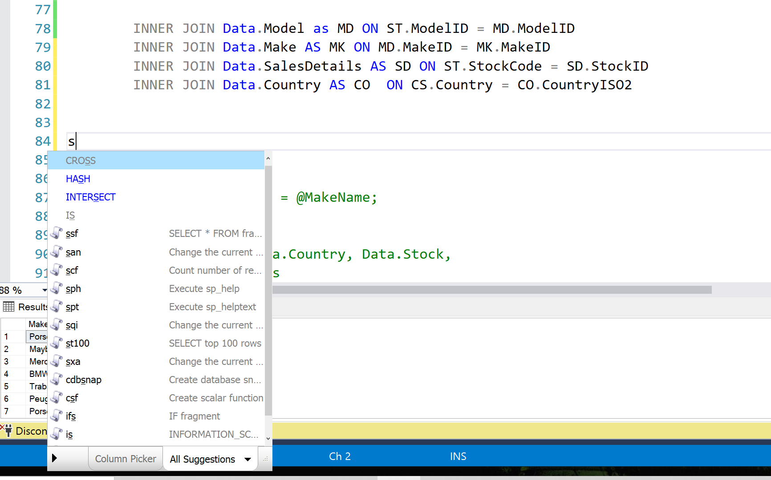
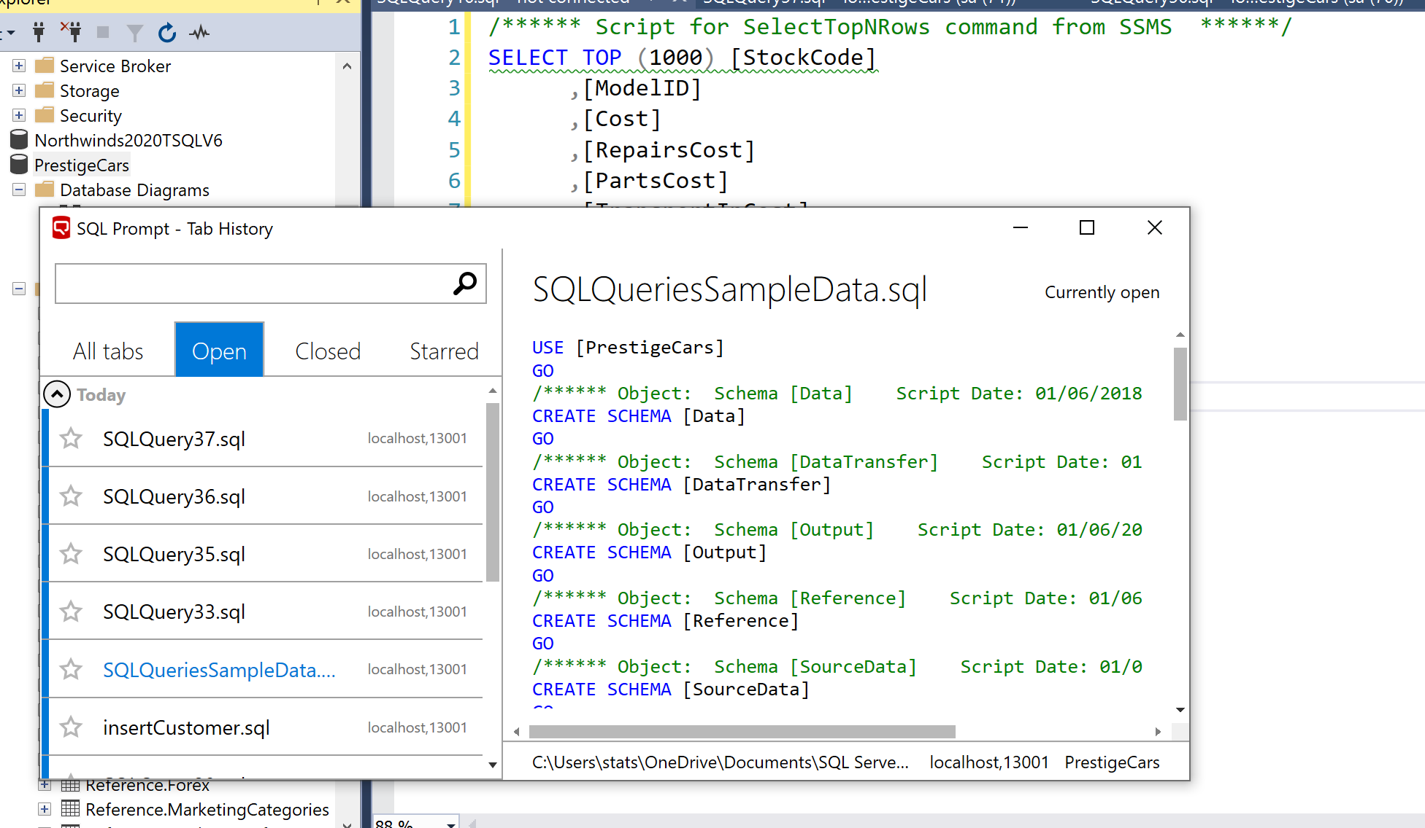
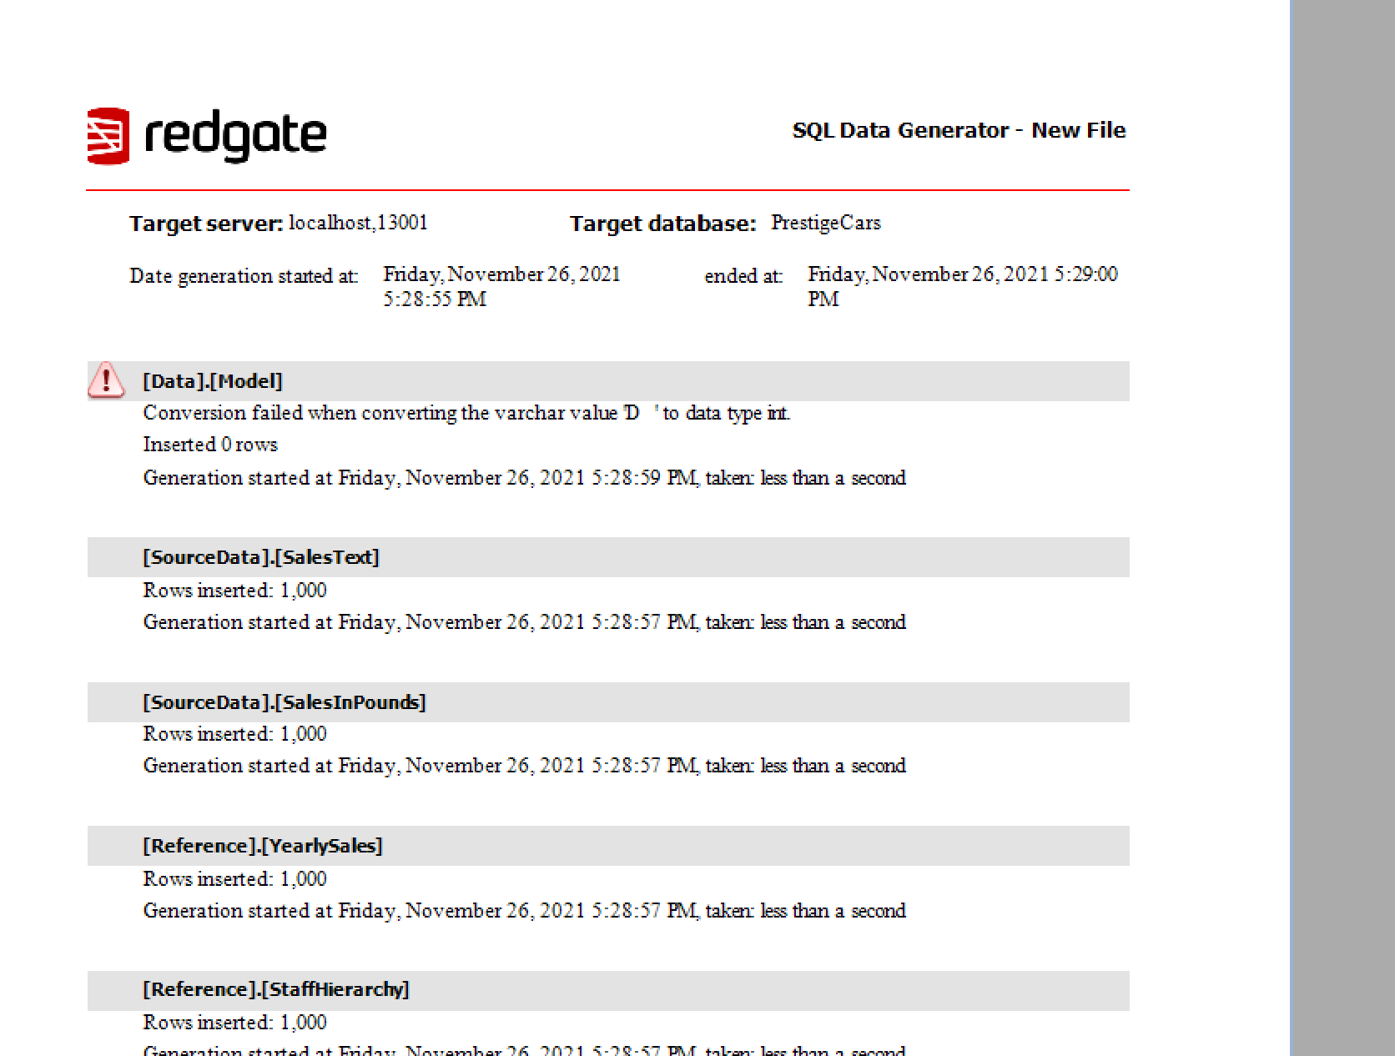

Slide 9
Data.Country
Data.Country table was split into 2 tables, Data.Country and Data.SalesRegion for normalization and reducing redundancy
Primary and Foreign keys were added to establish relationships
UDT’s were created and added to the tables for reuse
Constraints were added for data cleansing and to maintain proper data in the tables

Slide 10
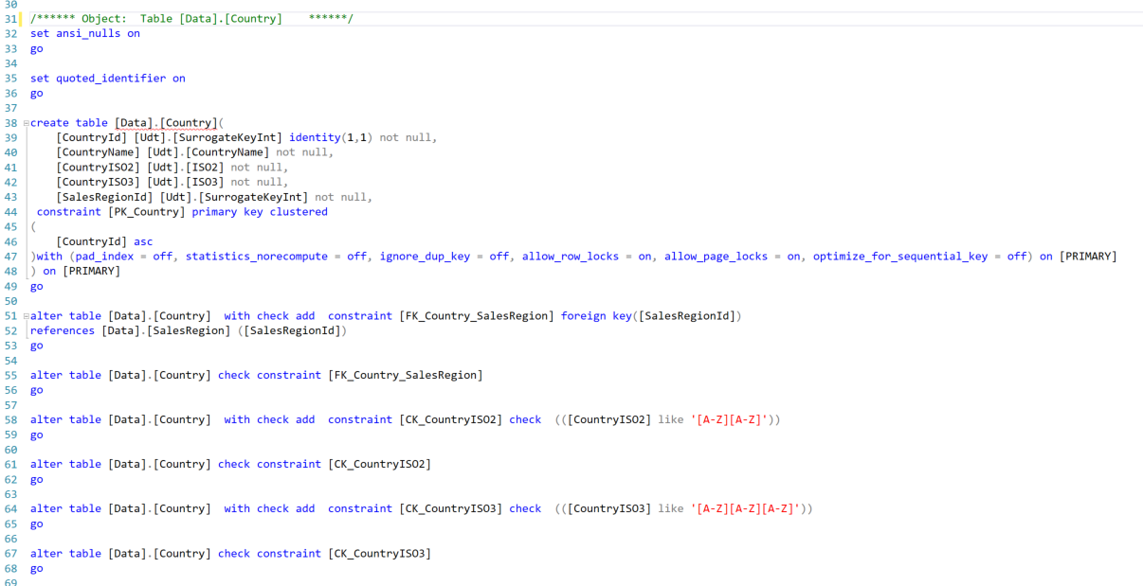
Data.Country

Slide 11
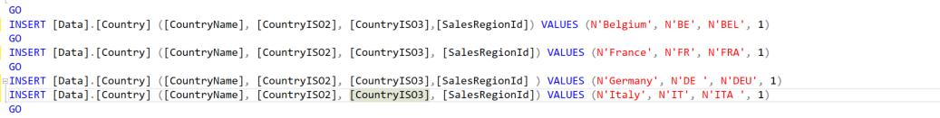
Inserting Country Data Before
Inserting Country Data After

Slide 12
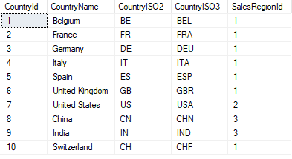

Slide 13
Adding Constraints
Foreign key added to create a relationship between Data.Country table and Data.SalesRegion
Constraints were added to maintain correct data in the CountryISO2 and CountryISO3 columns

Slide 14
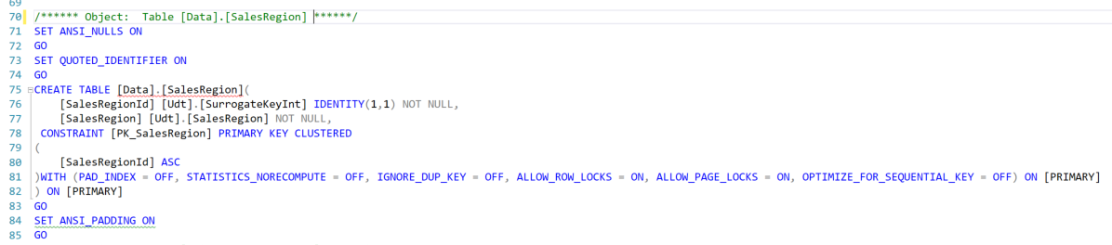
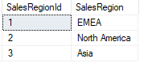
Data.SalesRegion Table

Slide 15
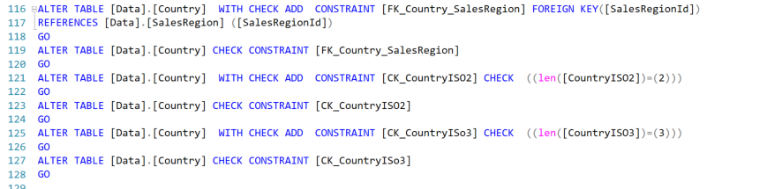
Constraints for the table

Slide 16
Data.Customer
For Customer table I deleted the first column which was an entry for each CustomerId
For the data type of CustomerId i used an identity type so we didn’t have to enter a nvarchar type for Id.
CustomerId is made as our primary key and we use UDT types for most of our columns
I ended up deleting the column [IsReseller] because the column had no tie to any other table so it just seemed useless to have
Originally wanted to pass in CountryId into this table as a foreign key but values just appeared as null so i got rid of it

Slide 17
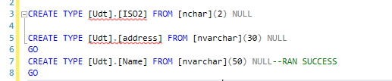
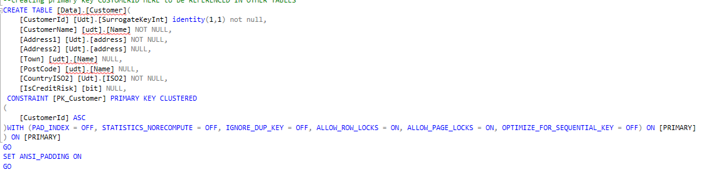
Data.Customer

Slide 18
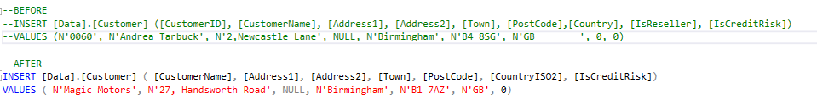
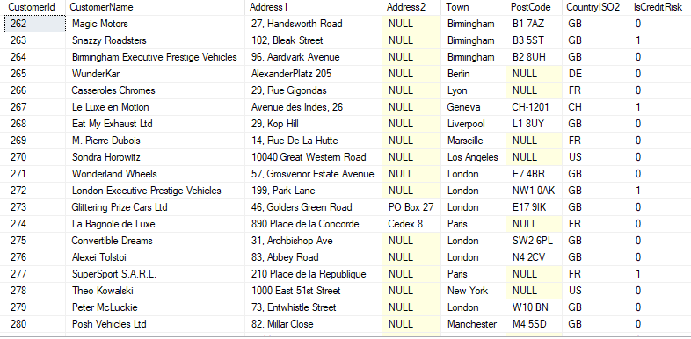
Data.Customer

Slide 19
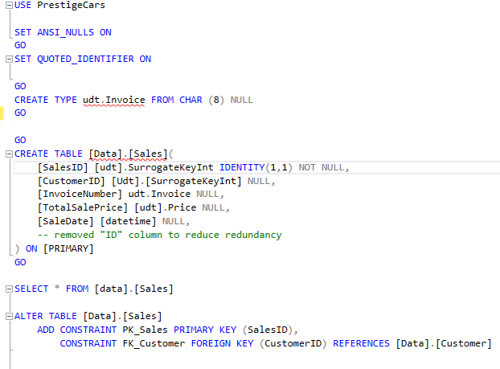
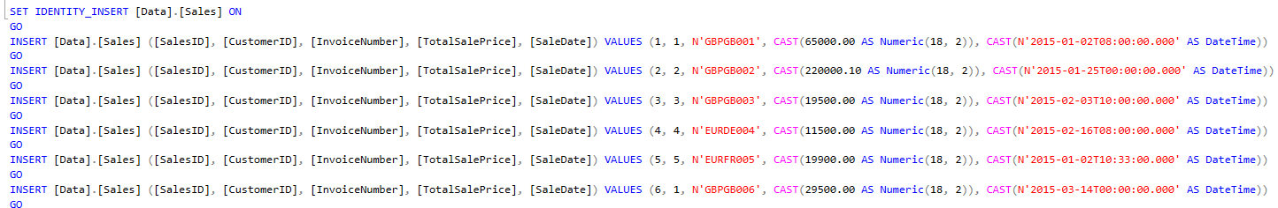
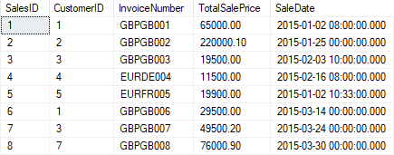
Data.Sales

Slide 20
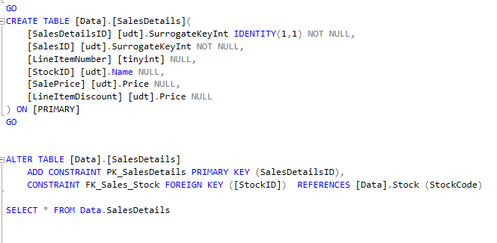
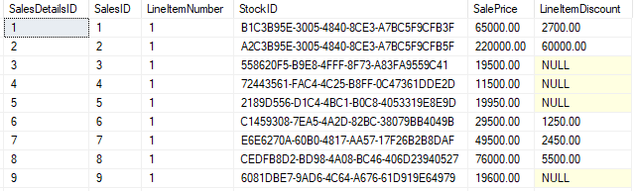
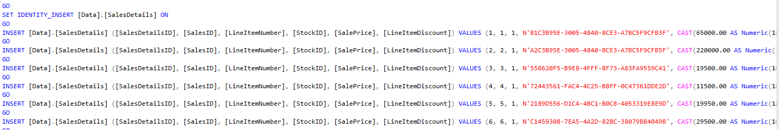
Data.SalesDetails

Slide 21
Data.Stock
PROCEDURE:
Created a StockID
Made the StockID as the Primary key
Made the Model ID as the foreign key and did some check constraints
NOTES:
Data.Stock was extremely huge so we used StockIDs so it could be referenced easily
Other tables that need information based on a stock code could use the stockid instead of typing out the whole code.
ModelID was a foreign key so we needed to make a constraint for it.

Slide 22
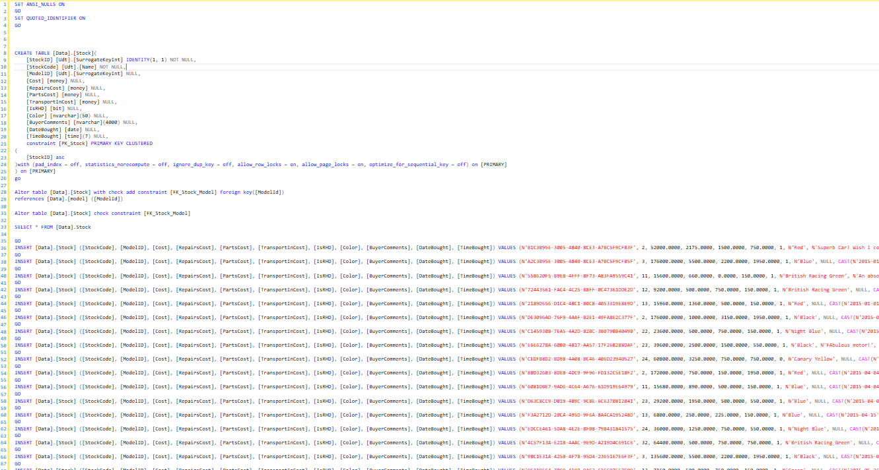
Data.Stock

Slide 23
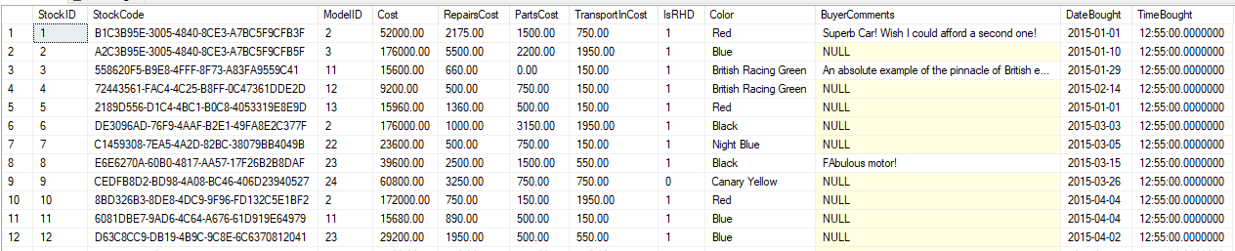
Data.Stock

Slide 24
Data.Make
The Table of Data.[make] contains the columns of makeID,MakeName, and MakeCountry
First, we use the IDENTITY to define the id of the makes
Then, we set the MakeID is the PK in the table
And also , we add the constraint to make sure that the value we gonna insert is right
Finally , we insert the values.

Slide 25
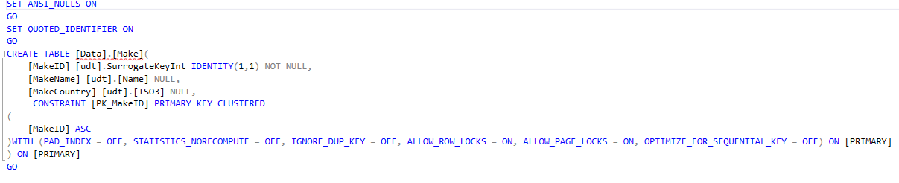
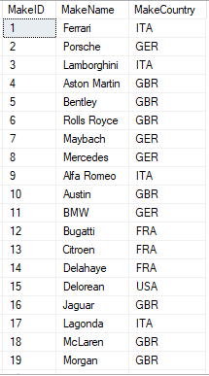
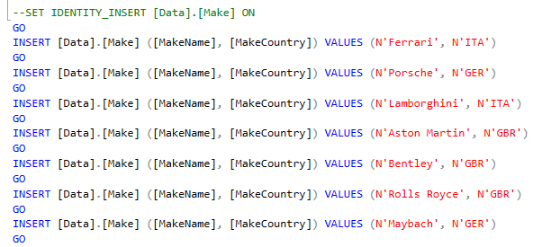
Data.Make

Slide 26
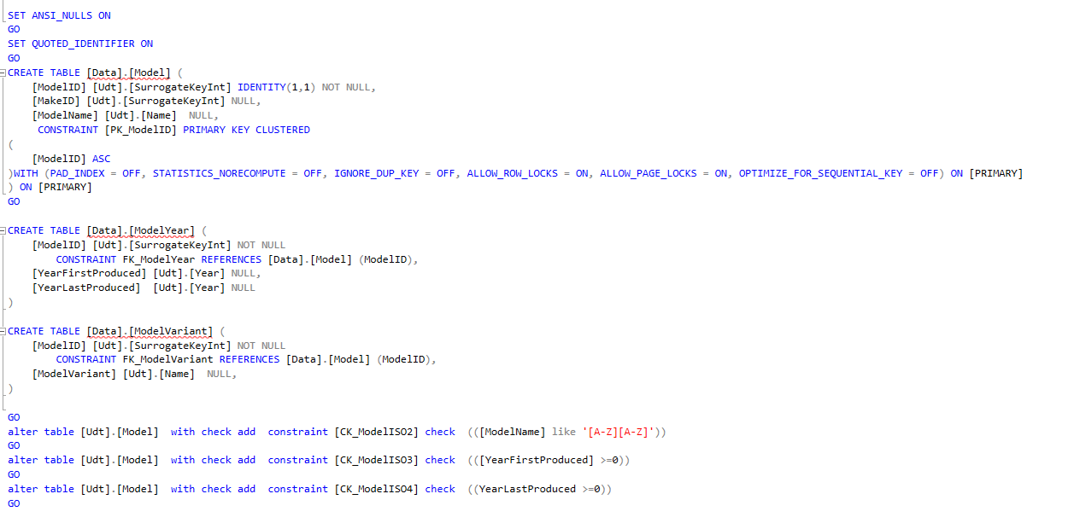
Data.Model
Data.Model was divided up into 3 tables, as there were almost all NULL in year and variant columns, in order to better cleanse our data we designed multiple model years and model variants into a separate tables. Also allowing for greater normalization

Slide 27
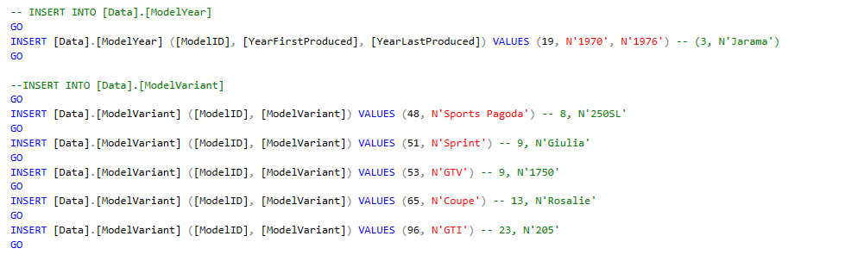
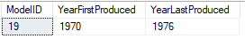
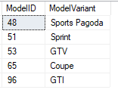
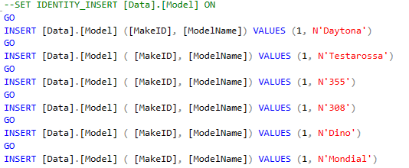
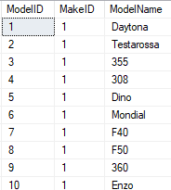
Data.Model Continued

Slide 28
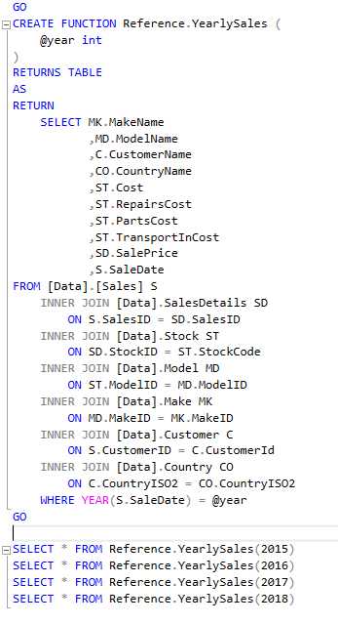
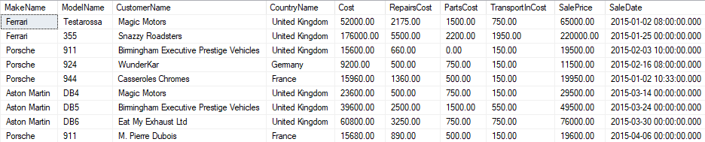
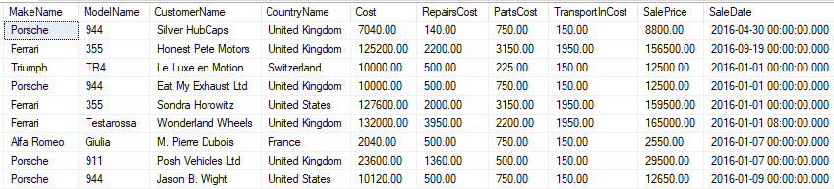
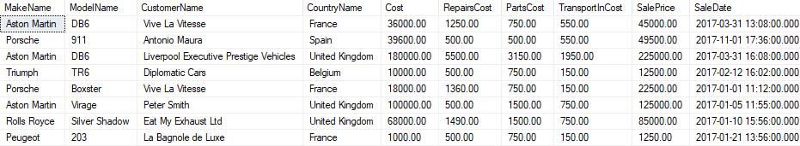
Reference.YearlySales
Consolidated 5 Tables into one useful Table Valued Function

Slide 29
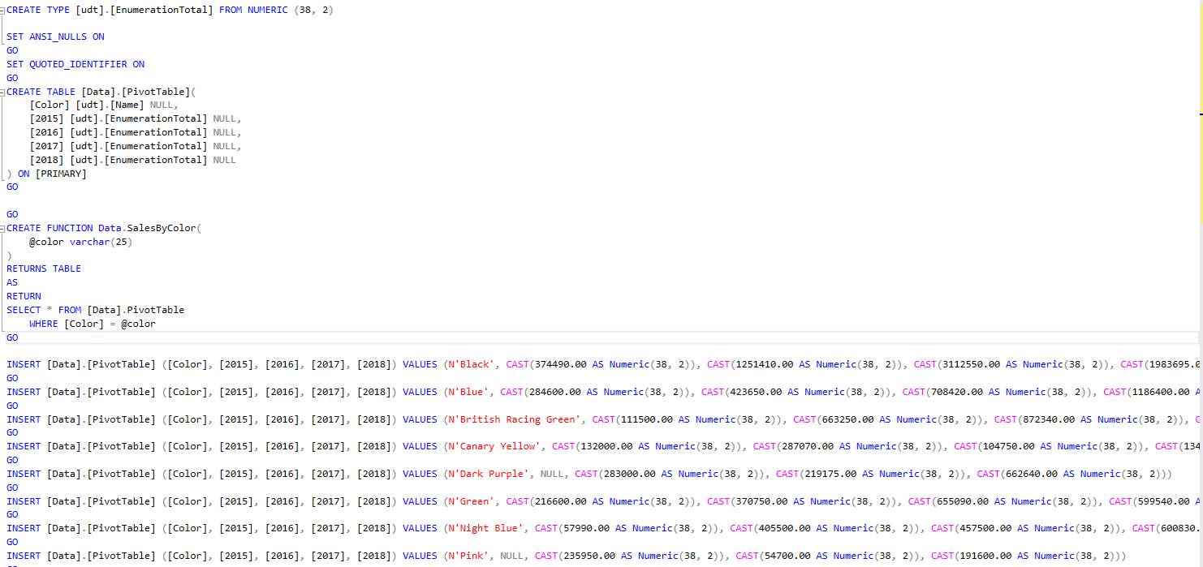
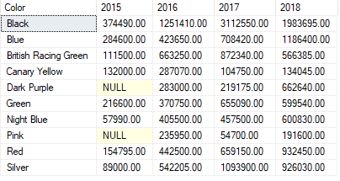
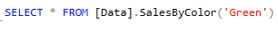
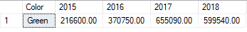
Data.PivotTable

Slide 30
Output.StockPrice
This table needed the make name, model name, and the cost of the model.
All of these come from different tables.
Make name comes from the make table, model name comes from the model table, and cost comes from the stock table.To join them Inner joins must be used.
We join the stock table with the model table by the model id and then join the make table by make id.

Slide 31
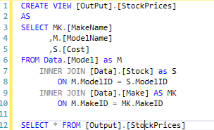
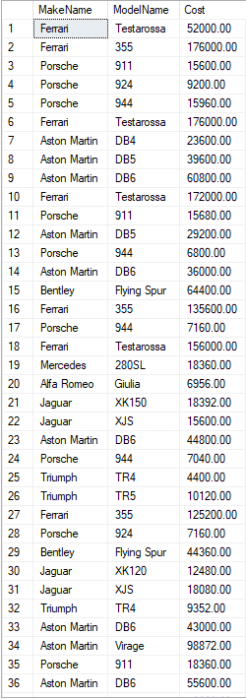
Output.StockPrice

Slide 32
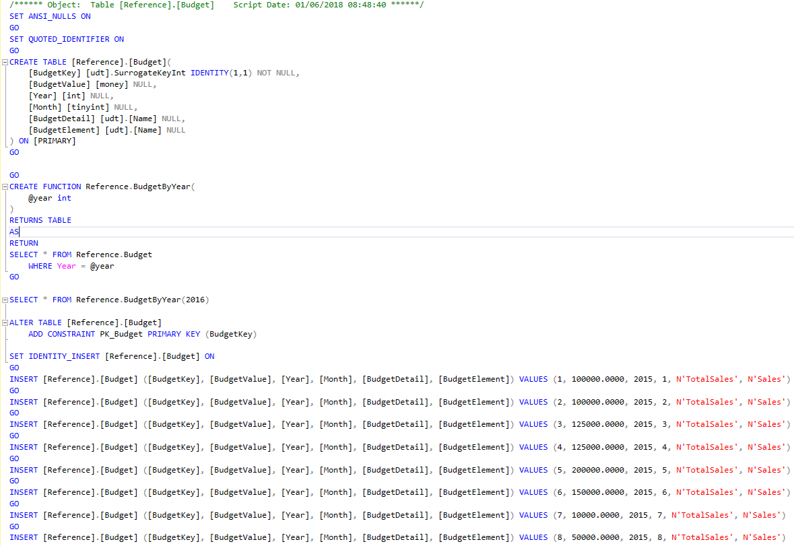
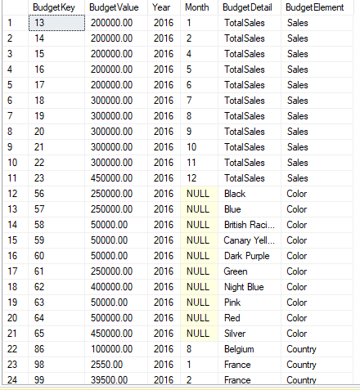
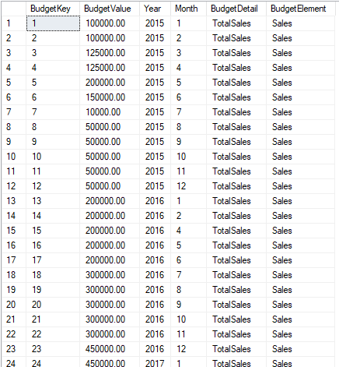
Reference.Budget

Slide 33
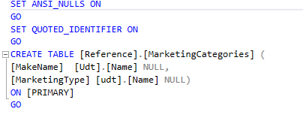
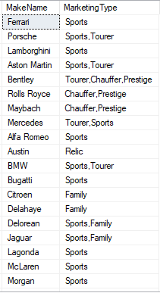



Reference.MarketingCategories

Slide 34
Reference.MarketingInformation
For this table I renamed the columns to be more clear for the user and specified what kind of type we were accepting for the country column
Also change the types for the columns. For CustomerName I reduced nvarchar from (150) to (50) and for CountryISO2 I reduced it to (2) with a constraint that makes sure that the first 2 letters are from the alphabet
Compared to the original input for this table I just had to shorten the Country column to a smaller input
Then I created a function out of it were originally I wanted user to search by spendcapacity but it was later made clear that it should be more specified so we changed it to search by CustomerName.
Function will return a table with all it’s columns given the specified Customer Name

Slide 35




Reference.MarketingInformation

Slide 36


Reference.SalesBudget

Slide 37






Reference.Staff

Slide 38


Reference.StaffHierarchy

Slide 39


SourceData.SalesInPounds

Slide 40
SourceData.SalesText
For this data we created a View that was stored in the database and made reusable
View was created by using an Inner Join on a Data.Sales, Data.SalesDetails, Data.Stock, Data.Model, Data.Make, Data.Customer and Data.Country tables
Using foreign key and primary key relationships we were able to join all these tables without initializing another table but rather creating a View which could be reused and is stored in the database.

Slide 41

SourceData.SalesText

Slide 42


